Slide 1

CSCI 476: Computer Security
Shellshock Attack (Part 1)
Reese Pearsall
Fall 2024
*all images are stolen from the internet
https://www.cs.montana.edu/pearsall/classes/fall2024/476/main.html

Slide 2
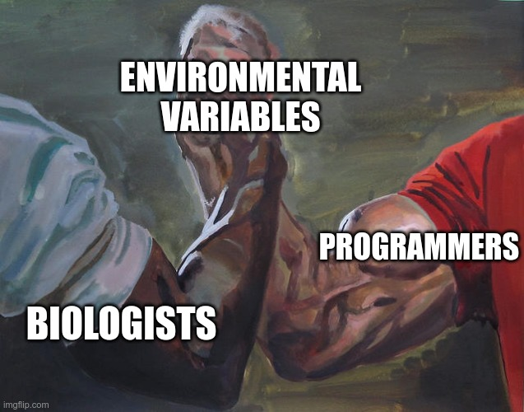
Announcements
Lab 1 (Set-UID) due on Sunday 9/22

Slide 3
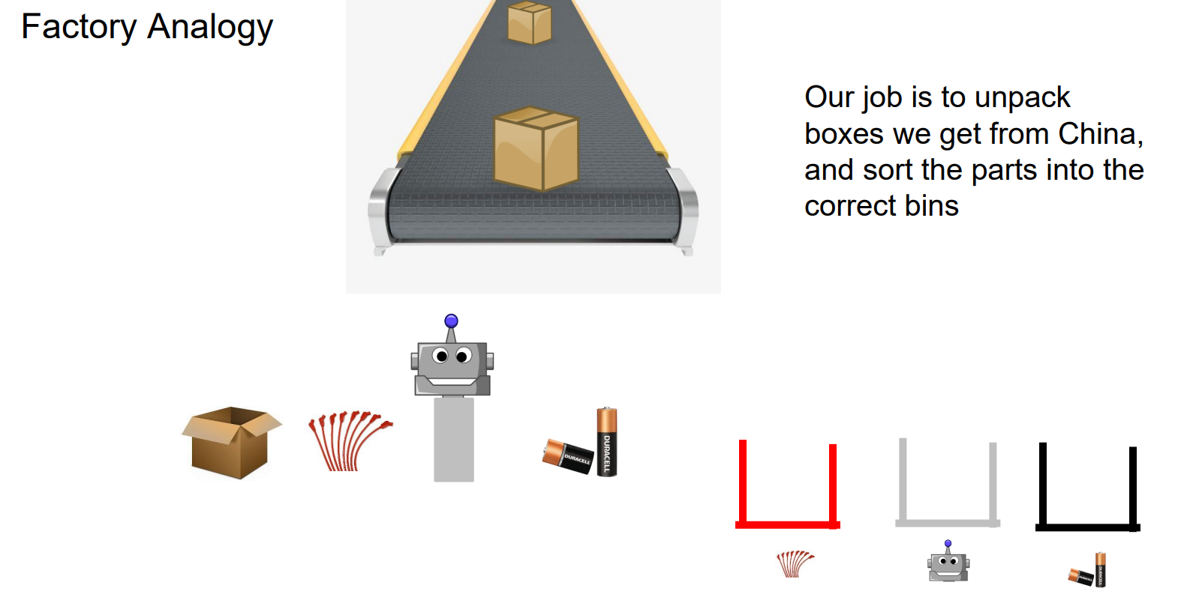

Slide 4
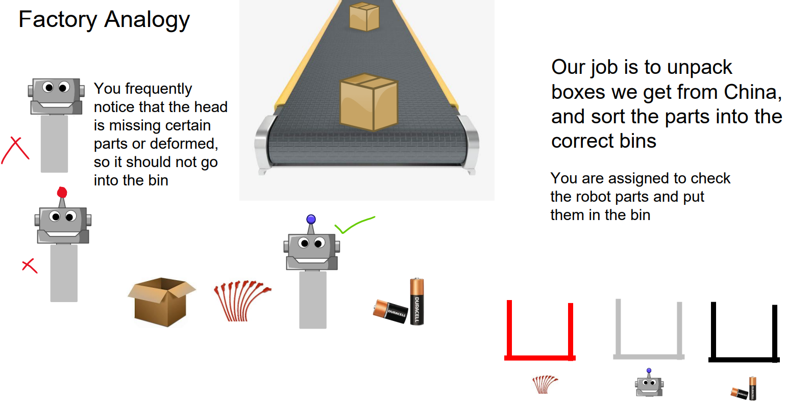

Slide 5
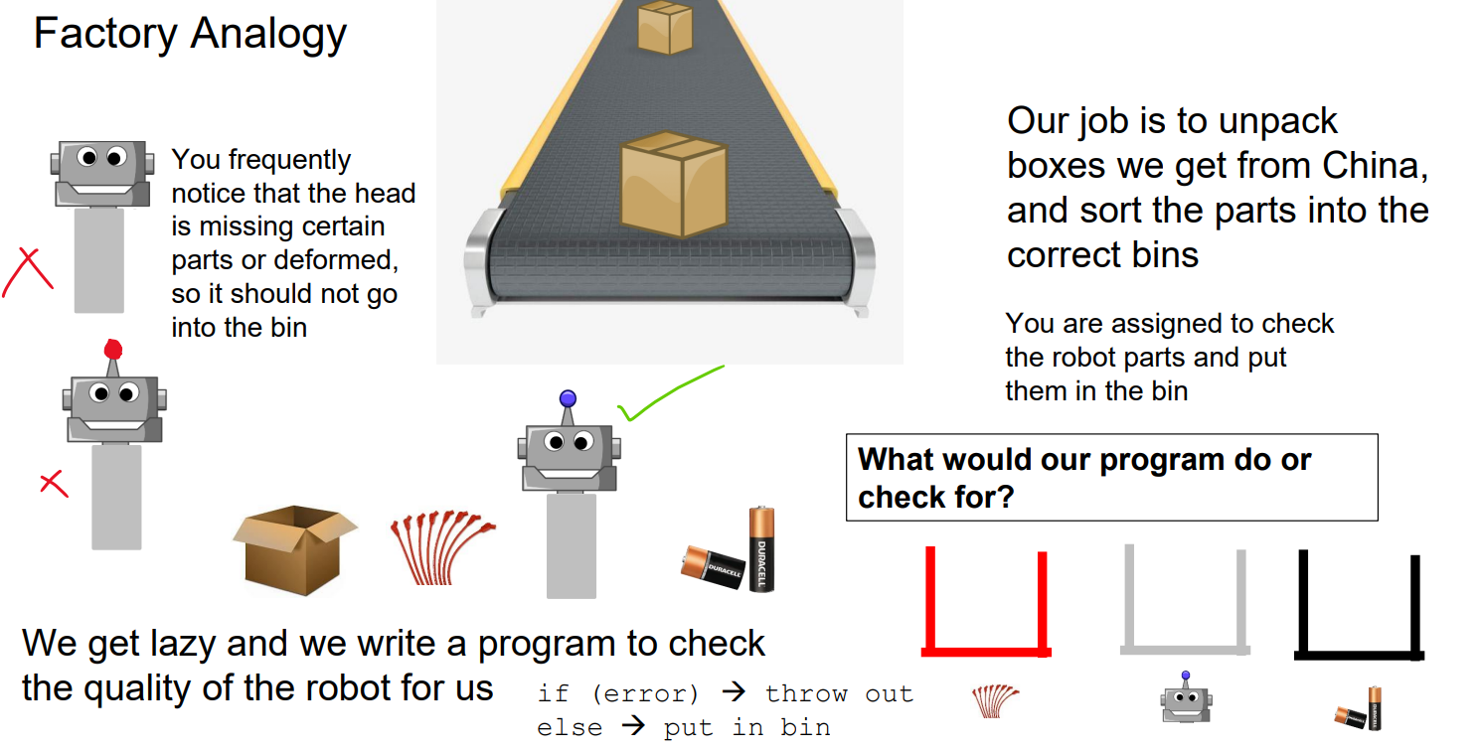

Slide 6
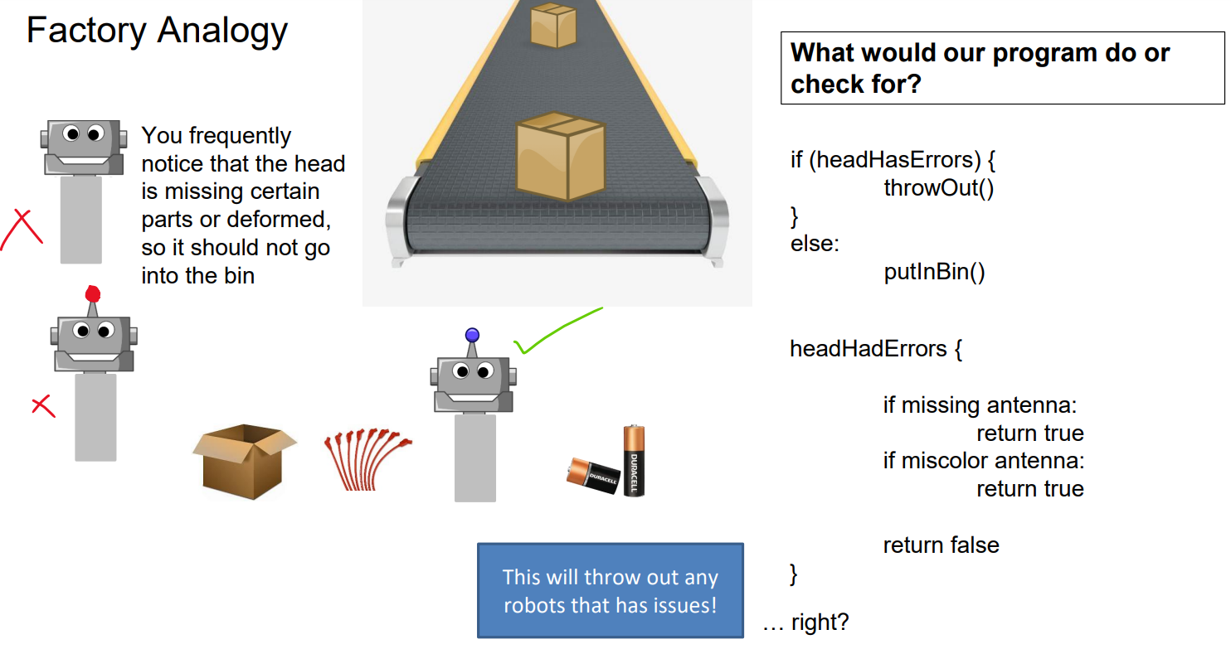

Slide 7
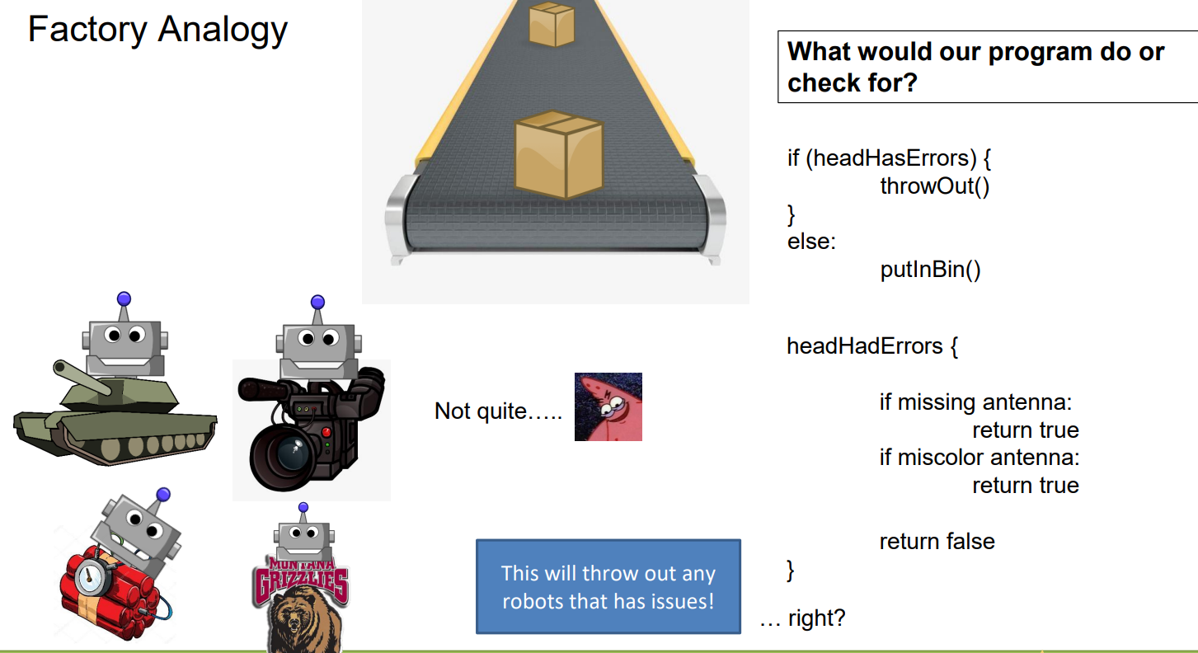

Slide 8
Shellshock
A shell is a command-line interpreter
Provides an interface between the user and OS
There are different types of shell: sh, bash, csh, dash, etc
The bash shell is one of the most popular shell programs; often used in Linux OS
The Shellshock vulnerability (Lab 02) results from how shell functions and environment variables are handled in the bash shell

Slide 9

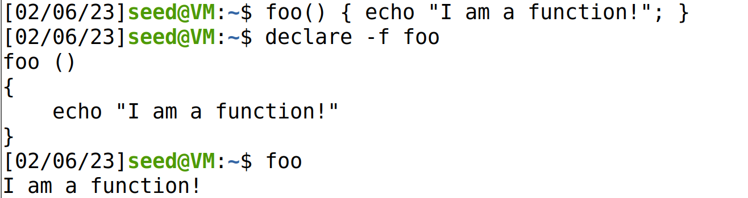
Shell Function
A shell function is a collection of commands to be executed under a certain name
We can use define a function a function, and declare it for use with the declare command

Slide 10
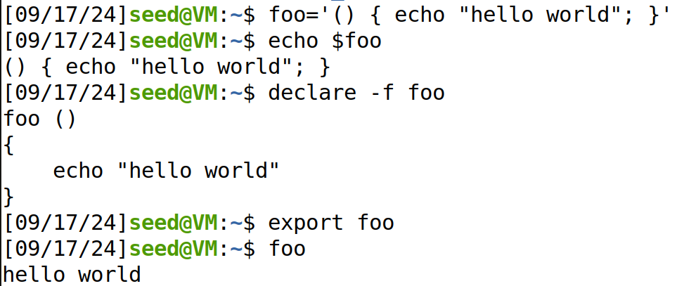

Shell Function
A shell function is a collection of commands to be executed under a certain name
We can also define the shell function as an environment variable

Slide 11
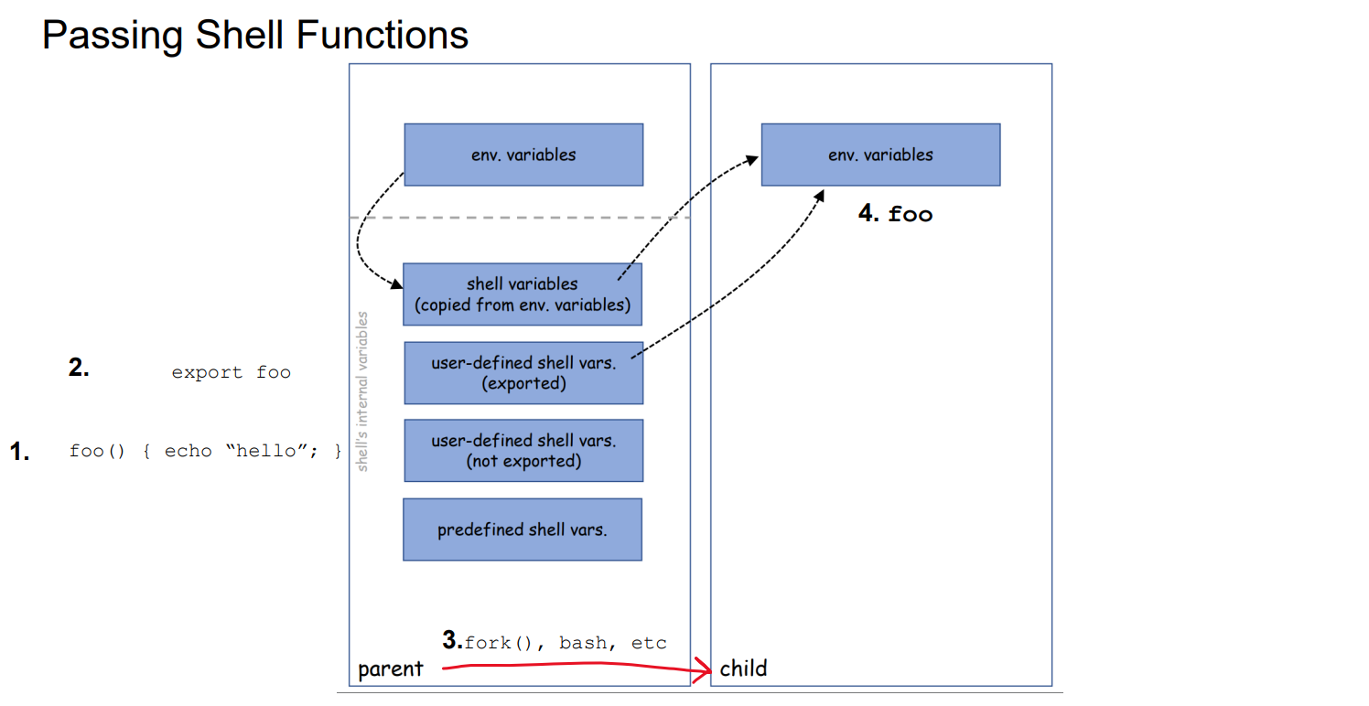
Shell functions can be passed from process to process as environment variables

Slide 12

Getting a vulnerable bash on our VM
The shellshock attack needs a vulnerable version of bash, so we will first acquire a vulnerable version to test with
The vulnerable version of the bash shell can be found in the image_www folder
We can copy it into our local workspace with the cp command
We can now run a vulnerable version of bash using bash_shellshock

Slide 13
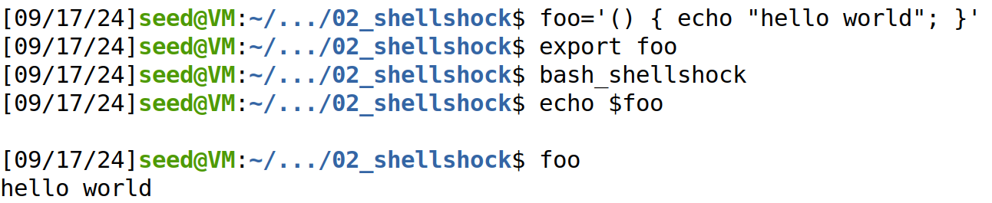

Shell functions can be passed from process to process as environment variables
In the parent process, we defined the foo function as an environment variable
(parent process)
(parent process)
(Starts a new bash instance)
(child process)
(child process)
In the child process, it became a shell function (no longer an env var!)
(child process)

Slide 14

Shell functions can be passed from process to process as environment variables
In the parent process, we defined the foo function as an environment variable
(parent process)
(parent process)
(Starts a new bash instance)
(child process)
(child process)
In the child process, it became a shell function (no longer an env var!)
Important: Shell will parse environment variables, and if it finds a valid function definition, it will be converted to a shell function!
(child process)

Slide 15
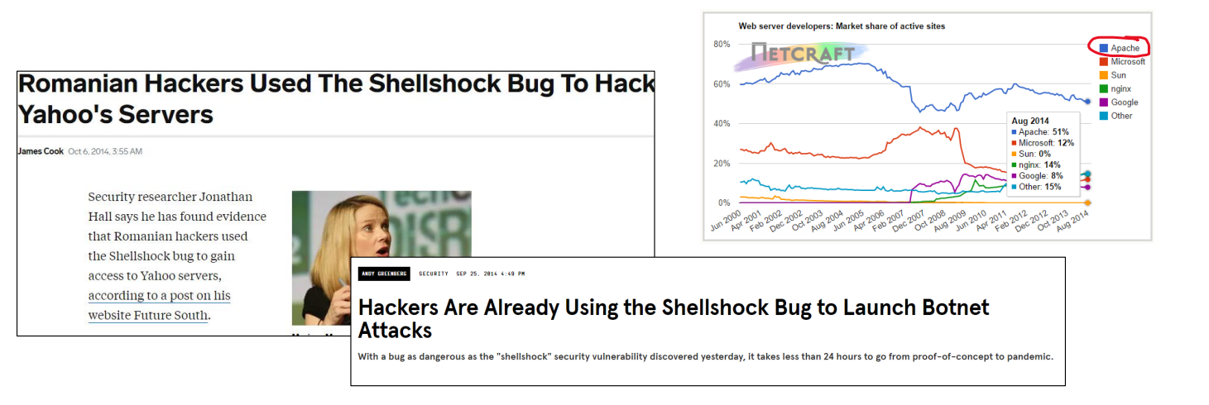
Shellshock
The Vulnerability
Shellshock was classified as being an extremely critical big. Low complexity and high potential damage

Slide 16
Shellshock
The Vulnerability
(aka shellshock, bashbug, bashdoor)
Disclosed Sept 24th, 2014
This vulnerability exploited a mistake made by bash when it converts env. vars. to function definitions
Additional bugs were found in bash source code after disclosure of shellshock
The bug has existed in bash source code since August of 1989
CVE-2014-6271: https://cve.mitre.org/cgi-bin/cvename.cgi?name=CVE-2014-6271

Slide 17
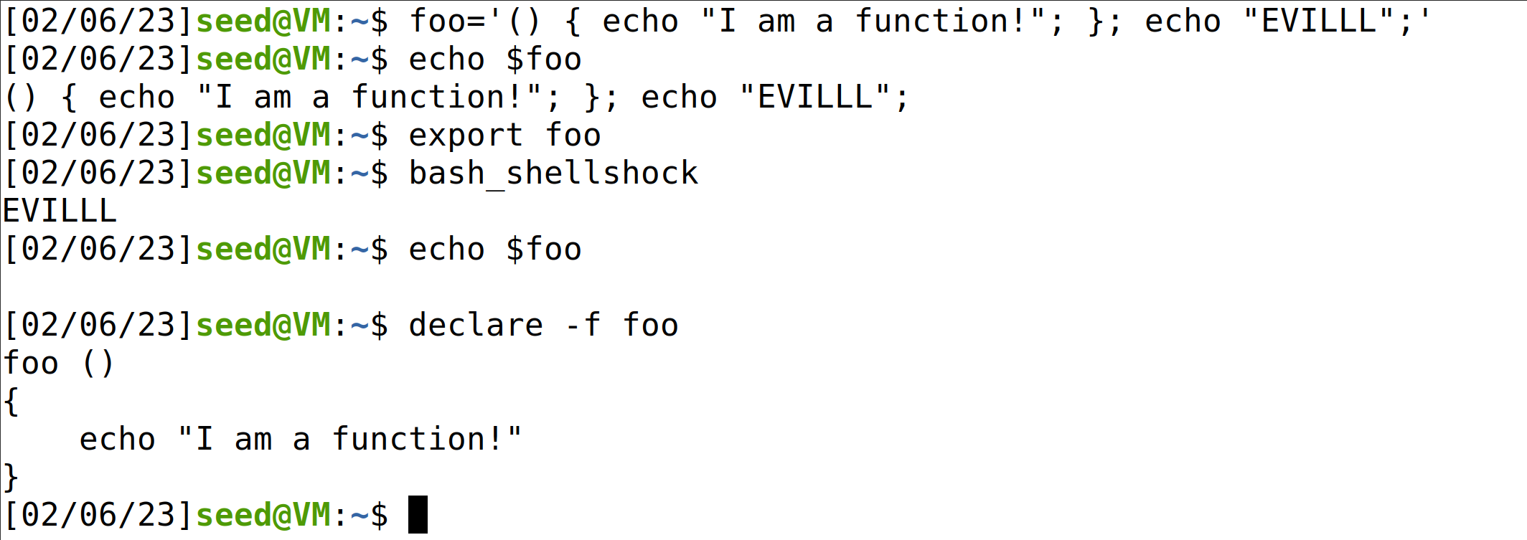
Shellshock Vulnerability Demo
Shell function
An extra command
We define a new environment variable that has a valid function definition, but we tack on an extra command (echo ‘EVILLLL’)

Slide 18
Shellshock Vulnerability Demo
Shell function
An extra command
We export it, and then create a new bash instance (aka a new child process)
(Remember: environment variables get inherited by a child process)

Slide 19


Shellshock Vulnerability Demo
Shell function
An extra command
!!!! Our extra command we tacked on earlier gets executed by bash!

Slide 20


Shellshock Vulnerability Demo
Shell function
An extra command
!!!! Our extra command we tacked on earlier gets executed by bash!
Additionally, foo is now a function

Slide 21

Shellshock Vulnerability Demo
Shell function
An extra command
Due to a parsing bug when processing env. variables, bash executes trailing commands in env. variables

Slide 22
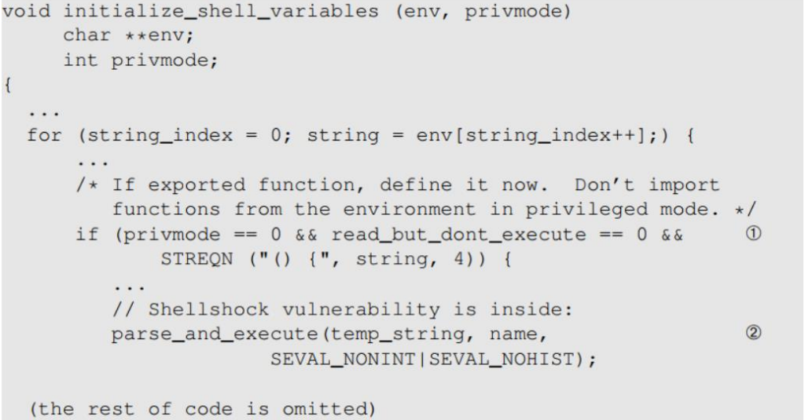
The Mistake
The shellshock bug starts in variables.c file in the bash source code

Slide 23
The Mistake
The shellshock bug starts in variables.c file in the bash source code
If the first four characters of the environment variable are “() {“, then parse and execute the command(s)

Slide 24
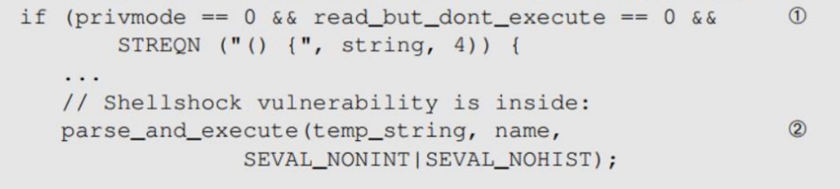
The Mistake
If bash thinks it finds an exported function, then it calls the function parse_and_execute() to parse the function definition
If the string contains a shell command (echo, rm, touch), then……

Slide 25

The Mistake
If bash thinks it finds an exported function, then it calls the function parse_and_execute() to parse the function definition
If the string contains a shell command (echo, rm, touch), then……
Execute it!!!

Slide 26

The Mistake
If bash thinks it finds an exported function, then it calls the function parse_and_execute() to parse the function definition
Bash only looks at first four characters, and assumes everything after that is a valid function body with no extra shell commands (bad)

Slide 27
The Mistake
Bash identifies A as a function because of the leading “() {“ and converts it to B
[A] foo=() { echo “hello world”; }; echo “extra”;
[B] foo () { echo “hello world”; }; echo “extra”;
In B, the string now becomes two commands
Consequences?

Slide 28
The Mistake
Bash identifies A as a function because of the leading “() {“ and converts it to B
[A] foo=() { echo “hello world”; }; echo “extra”;
[B] foo () { echo “hello world”; }; echo “extra”;
In B, the string now becomes two commands
Consequences?
Using environment variables, attackers can get a process to run their commands
If a target process is a server process or runs with elevated privileges, bad things can happen

Slide 29


The Mistake
Bash identifies A as a function because of the leading “() {“ and converts it to B
[A] foo=() { echo “hello world”; }; echo “extra”;
[B] foo () { echo “hello world”; }; echo “extra”;
In B, the string now becomes two commands
“Arbitrary code”
Consequences?
Using environment variables, attackers can get a process to run their commands
If a target process is a server process or runs with elevated privileges, bad things can happen

Slide 30
The Shellshock Vulnerability
The shellshock vulnerability is a bug in the code when converting environment variables to function definitions, which allows for an attacker to execute arbitrary code
Two conditions are needed to exploit the vulnerability
The target process must run a vulnerable version of bash
The target process gets untrusted user input via environment variables
Shellshock
Execute a bash shell
Trigger flawed parsing logic
Env variables containing function definitions

Slide 31


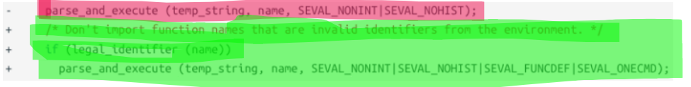
The Shellshock Vulnerability
Patches are available, but have they been applied to every system?
(New if statement that checks for only function definitions and executes one command)

Slide 32
To make this a more realistic scenario, we are going to attack a mock server that is running the vulnerable version of bash
DO NOT try a shellshock attack on a legitimate running server

Slide 33
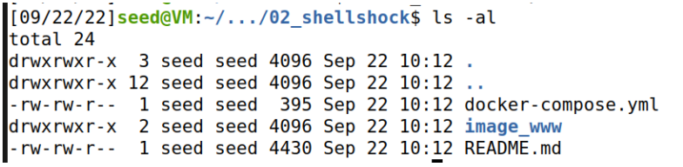
To make this a more realistic scenario, we are going to attack a mock server that is running the vulnerable version of bash
(In our GitHub code repository)

Slide 34

To make this a more realistic scenario, we are going to attack a mock server that is running the vulnerable version of bash
Folder that contains the contents for our web server
(In our GitHub code repository)

Slide 35


To make this a more realistic scenario, we are going to attack a mock server that is running the vulnerable version of bash
Script that will create a docker container that will manage our web server
(In our GitHub code repository)

Slide 36

Docker

Slide 37
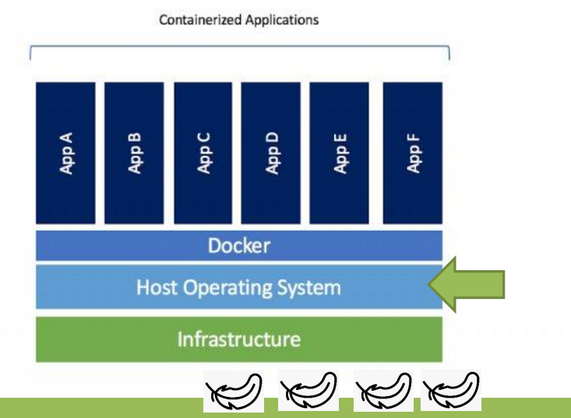
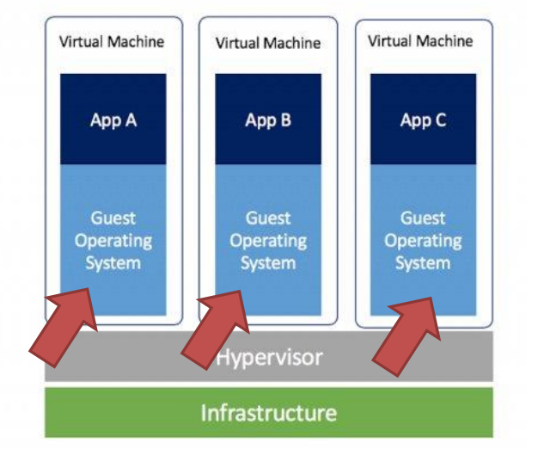
Docker is an open-source platform for building, deploying and managing containerized applications
containers use the docker platform, which uses the host operating system
virtual machines all have their own operating system

Slide 38
Host (Your actual computer)
SEED Labs VM (“Guest”)
10.9.0.1
Docker Container (web server)
10.9.0.80
(www.seedlab-shellshock.com)

Slide 39
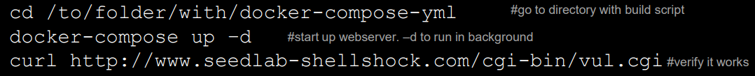
Setting up your Docker container
docker-compose up –d is used to start the web server
(-d stands for “detached” and lets the web server run in the background)
docker-compose down #turns the server off
docker ps -a #view active containers and their ids
docksh <id> #connect/log in to a container

Slide 40
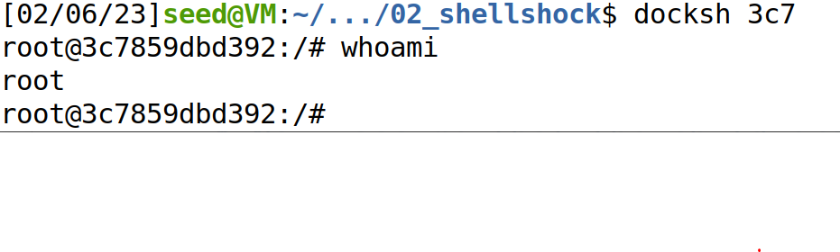

(You don’t need to provide the full container ID)
We are now logged into the docker container!

Slide 41






SEED Labs VM (“Guest”)
10.9.0.80
(www.seedlab-shellshock.com)
ENV Variables
Process on our VM
Uses
We must find a way to get shellshock to trigger on a remote server

